Slide 1

AutoHacking with Phoenix Enabled Data Flow Analysis
Richard Johnson | switech@microsoft.com

Slide 2
Topics
Phoenix
Architecture
Fundamentals
Program Analysis
Call Flow
Control Flow
Data Flow
Applied Program Analysis
API Path Validation
Integer Overflow Detection
Syntax Model Inference

Slide 3
Introducing Phoenix
Framework for building compilers and program analysis tools
Collaborative project between the Microsoft Research, Visual C++, and .NET Common Language Runtime groups at Microsoft
Foundation for the next generation of Microsoft development tools

Slide 4
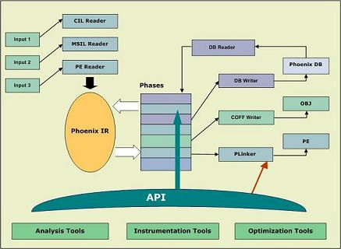
Phoenix Architecture
Inputs are converted to an intermediate representation (IR)
Phoenix API allows compiler plug-ins or standalone tools to add or hook phases of IR creation

Slide 5
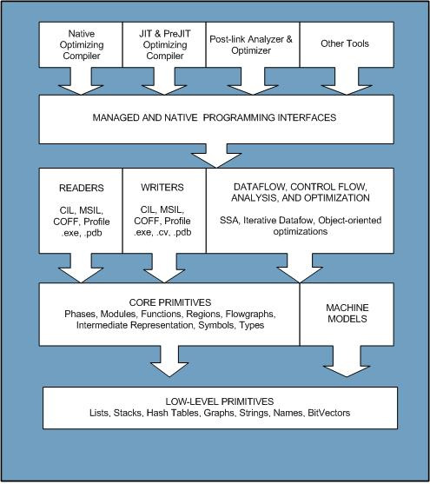
Phoenix Architecture
Phases process IR to provide abstractions such as call graphs, flow graphs, region graphs, single static assignment (SSA) annotations

Slide 6
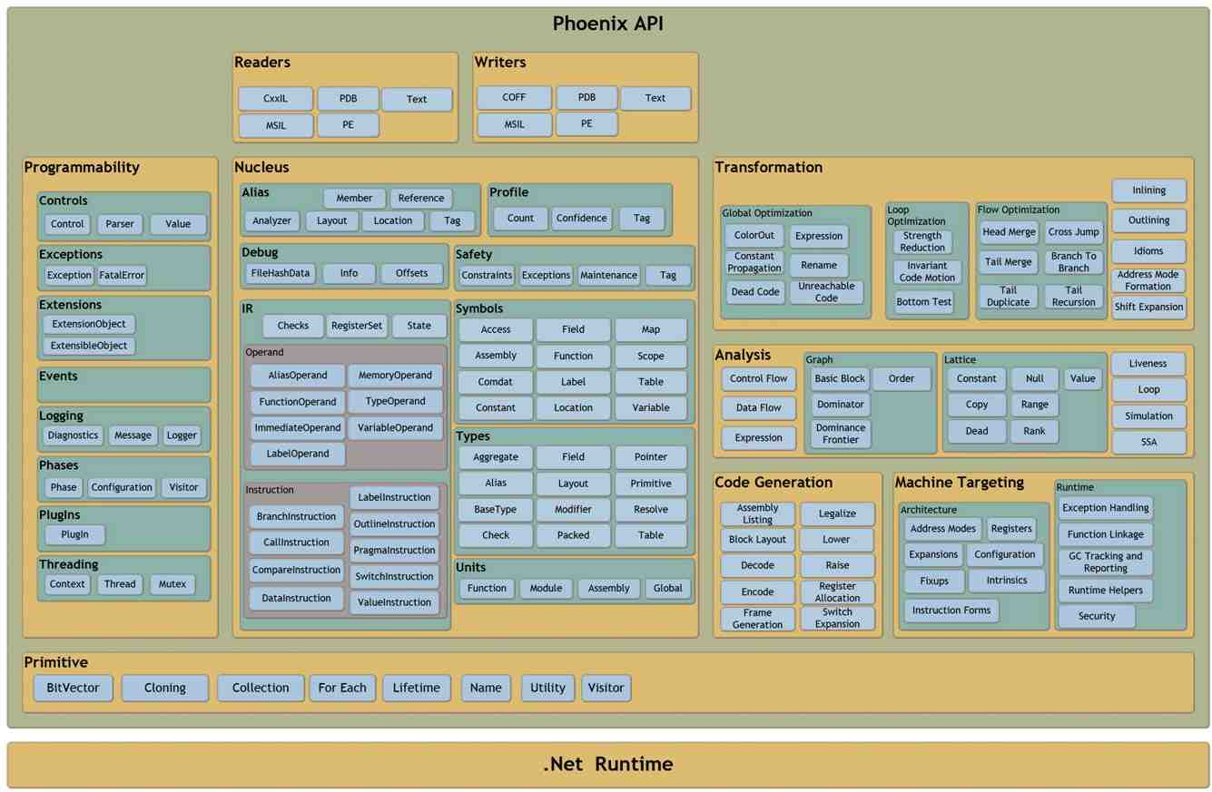
Phoenix Architecture

Slide 7
Phoenix Applications
Compiler development
Optimization
Retargeting
Binary Instrumentation
Profiling/Code coverage
Binary protection/obfuscation
Program Analysis
Model inference
Vulnerability detection

Slide 8
Using Phoenix
Load targets manually or via plug-ins
Use phase lists or raise binaries manually
PEModuleUnit module = null;
module = PEModuleUnit.Open(path);
module.LoadPdb();
module.LoadGlobalSymbols();
Phx.Symbols.Table table = module.SymbolTable;
Phx.Symbols.LocalIdMap localMap = table.LocalIdMap;
Phx.Collections.IdToSymbolMap symbolMap = localMap.InternalMap;
Phx.Collections.IdToSymbolMap.Iterator iterator =
new Phx.Collections.IdToSymbolMap.Iterator(symbolMap);
while (iterator.MoveNext())
{
if (iterator.CurrentValue.IsFunctionSymbol)
{
FunctionSymbol function = iterator.CurrentValue.AsFunctionSymbol;

Slide 9
Using Phoenix
Load targets manually or via plug-ins
Use phase lists or raise binaries manually
public class PlugIn : Phx.PlugIn {
public override void BuildPhases
(Phx.Phases.PhaseConfiguration config)
{
Phx.Phases.Phase funcNamesPhase;
funcNamesPhase = Phase.New(config);
Phx.Phases.Phase encodingPhase =
config.PhaseList.FindByName("Encoding");
encodingPhase.InsertBefore(funcNamesPhase);
}
public override System.String NameString
{
get { return "FuncNames"; }
}
public class Phase : Phx.Phases.Phase {
public static Phx.Phases.Phase
New (Phx.Phases.PhaseConfiguration config)
{
Phase phase = new Phase();
phase.Initialize(config, "FuncNames");
return phase;
}
protected override void
Execute (Phx.Unit unit)
{
if (!unit.IsFunctionUnit) return;
Phx.FunctionUnit function =
unit.AsFunctionUnit;

Slide 10
Using Phoenix
Units
Programs, Assemblies, Modules, Functions
Types
Primitives, Symbolic
Symbols
Static, Dynamic
Intermediate Representation
Primary abstraction of program semantics
Composed of Instructions and Operands
Three distinct levels of abstraction

Slide 11
Phoenix Intermediate Representation
High-level IR (HIR)
Architecture Independent
Abstract instructions represent runtime indirection
Operands refer to logical resources
More Abstract
Less Abstract
HIR
MIR
LIR
EIR
Lowering
Raising

Slide 12
Phoenix Intermediate Representation
Mid-level IR (MIR)
Architecture Independent
Runtime logic explicitly defined
Operands still refer to logical resources
More Abstract
Less Abstract
HIR
MIR
LIR
EIR
Lowering
Raising

Slide 13
Phoenix Intermediate Representation
Low-level IR (LIR)
Architecture dependent
Control flow explicit
Operands refer to logical or physical resources
More Abstract
Less Abstract
HIR
MIR
LIR
EIR
Lowering
Raising

Slide 14
Phoenix Instructions
Code or Data object
Source and Destination Operands
Annotation Operands
Types
Label
Value
Compare
Branch
Call
High-level IR
$L1: (references=0)
{*StaticTag}, {*NotAliasedTag} = START _main(T)
_main: (references=1)
_argc, _argv = ENTERFUNCTION
t273 = COMPARE(GT) _argc, 1
CONDITIONALBRANCH(True) t273, $L7, $L6
$L7: (references=1)
_message = ASSIGN &$SG3745
GOTO $L8
Low-level IR
$L1: (references=0)
{*StaticTag}, {*NotAliasedTag} = START WriteData(T)
WriteData: (references=1)
ENTERFUNCTION
Local0, {ESP} = push EBP
EBP = mov ESP
tv144- = mov 4112(0x00001010)
{ESP} = call _chkstk, {ESP}
offset = mov 8
tv144-, {ESP} = call CreateHeader, {ESP}
header = mov tv144-
$Stack+32928, {ESP} = push 8
$Stack+32960, {ESP} = push header
tv144- = lea &buf*

Slide 15
Phoenix Operands
Instruction arguments
Temporary Variables
Alias Tags
Alias Operands
Types
Memory
Constants
Variables
Functions
Labels
Alias Sets
High-level IR
$L1: (references=0)
{*StaticTag}, {*NotAliasedTag} = START _main(T)
_main: (references=1)
_argc, _argv = ENTERFUNCTION
t273 = COMPARE(GT) _argc, 1
CONDITIONALBRANCH(True) t273, $L7, $L6
$L7: (references=1)
_message = ASSIGN &$SG3745
GOTO $L8
Low-level IR
$L1: (references=0)
{*StaticTag}, {*NotAliasedTag} = START WriteData(T)
WriteData: (references=1)
ENTERFUNCTION
Local0, {ESP} = push EBP
EBP = mov ESP
tv144- = mov 4112(0x00001010)
{ESP} = call _chkstk, {ESP}
offset = mov 8
tv144-, {ESP} = call CreateHeader, {ESP}
header = mov tv144-
$Stack+32928, {ESP} = push 8
$Stack+32960, {ESP} = push header
tv144- = lea &buf*

Slide 16
Phoenix Alias Package
Alias System provides a memory model for static program analysis
Aliases abstract memory and register use by assigning tags to discrete locations
Alias Operands added to represent implicit effects of an instruction on memory
[ESP], {ESP} = push _message[EBP]

Slide 17
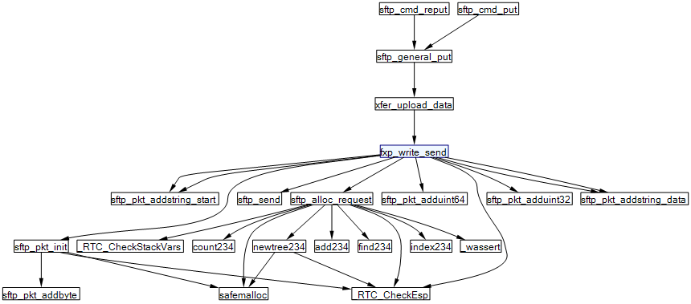
Call Graphs
A Call Graph is a visual representation of call relationships between functions

Slide 18
Call Graphs
Traditional call graph generation
Phoenix includes a Call Graph Package that provides module or program level function relationships
Collect all call edges
Find edges for Function
foreach(Function in ModuleFunctions)
foreach(CallInstruction in Instructions)
AddCallEdge(Function, CallTarget))
foreach(Edge in CallEdges)
if(Target == Function)
EdgesTo.Add(Edge)
if(Source == Function)
EdgesFrom.Add(Edge)

Slide 19
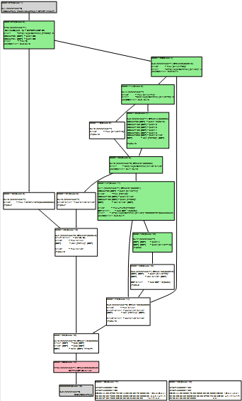
Control Flow Graphs
Control Flow Graph are visual representations of branch relationships between basic blocks
Phoenix provides a Control Flow Graph package that specifies edge types, node types, node dominance

Slide 20
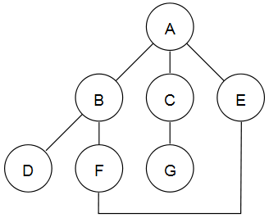
Graph Traversal
Depth First Search
Visit nodes following edges as deep as possible before returning to the next edge

Slide 21
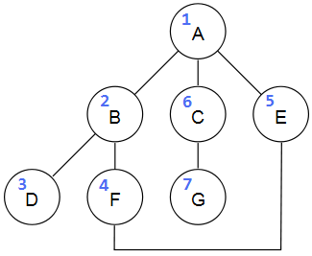
Graph Traversal
Depth First Search
Visit nodes following edges as deep as possible before returning to the next edge

Slide 22
Graph Traversal
Depth First Search
Visit nodes following edges as deep as possible before returning to the next edge
DFS Outputs
Spanning Tree (DAG)
Preordered Vertices
Postordered Vertices
Reverse Postorder Vertices

Slide 23
Reaching Definition Analysis
A variable assignment [x := a]^{l} may reach a code location if there is an execution of the program where x was last assigned at l when the code location is reached
An assignment reaches the entry of a block if it reaches the exit of any of the blocks that precede it

Slide 24
Reaching Definition Analysis
x = 5;
y = 1;
while (x > 1)
{
y = x * y;
--x;
}

Slide 25
Reaching Definition Analysis
[x = 5]¹
x = 5;
y = 1;
while (x > 1)
{
y = x * y;
--x;
}
[y = 1]²
[x > 1]³
[y = x * y]⁴
[--x]⁵

Slide 26
Reaching Definition Analysis
RD_{entry}
RD_{exit}
[x = 5]¹
1
2
3
4
5
(x, ?), (y, ?)
(x, 1), (y, ?)
(x, 1), (x, 5), (y, 2)
(x, 1), (x, 5) (y, 2), (y, 4)
(x, 1), (x, 5), (y, 4)
(x, 1), (y, ?)
(x, 1), (y, 2)
(x, 1), (x, 5), (y, 2)
(x, 1), (x, 5) (y, 4)
(x, 5), (y, 4)
[y = 1]²
[x > 1]³
[y = x * y]⁴
[--x]⁵

Slide 27
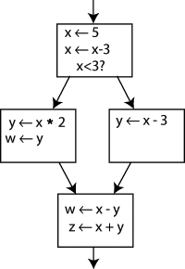
Single Static Assignment
Intermediate form used by several compilers in which every variable is assigned only once

Slide 28
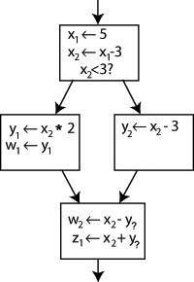
Single Static Assignment
Use-definition relationships explicit
Each use reached by only one definition
Each definition dominates all uses

Slide 29
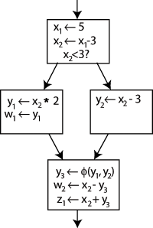
Single Static Assignment
Special Φ (Phi) instructions are added to the beginning of blocks to represent joins of different versions of the same variable

Slide 30
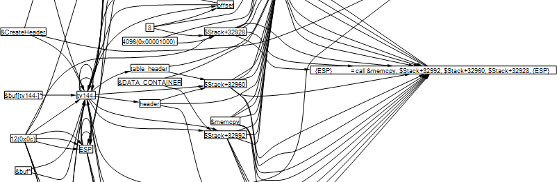
Data Flow Graphs
Reaching definitions allow the construction of a context-free data flow graph

Slide 31
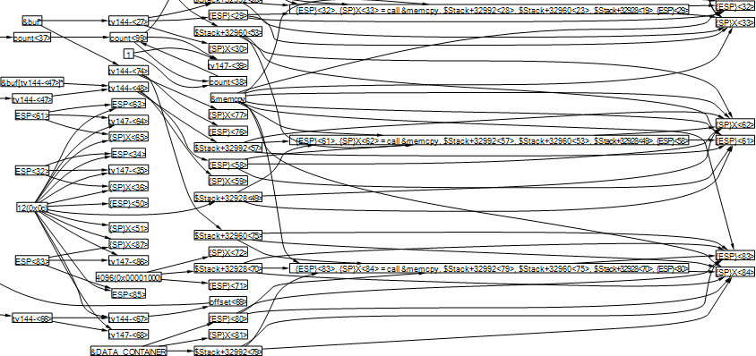
Data Flow Graphs
Converting to SSA form allows the simple construction of a contextual data flow graph

Slide 32
Applied Data Flow Analysis
API Path Validation
Determine whether there is a code path from data input function to a function using the data that does not flow through a sanitizing function
Method
Create an array of bit vectors to hold each path to each function
Propagate inherited bit vectors by performing a union on the two bit vectors
Real world use – SQL Injection prevention

Slide 33
Applied Data Flow Analysis
Syntax Model Inference
Determine the type layout of every abstract structure that reaches a specified function call
Method
Calculate call graph for target function
Gather Reaching Definition data for all functions in graph
Record type for each definition in each function
Walk unique call graph paths backwards collecting type flow information
Real world use – generate fuzzer definitions

Slide 34
Applied Data Flow Analysis
Integer Overflow Detection
Given a call to an allocation function, determine whether the input size could have wrapped
Method
Trace data input to memory allocation functions backward
Determine if the value is generated in with potentially user controlled data
Real world use – detect bugs!

Slide 35
Final Thoughts
Phoenix is amazingly powerful and extensible. It will change how academic compiler research is done on the Windows platform
The security industry has a lot to learn from the academic archives of the last 30 years. Read Dawson Engler, David Wagner, Cousot
Improved programming processes and advances in static analysis is and will continue to improve software security

Slide 36
Get Involved!
Get phoenix
http://research.micorosft.com/phoenix
Participate in online phoenix forums
Contact us at switech@microsoft.com

